Slide 1
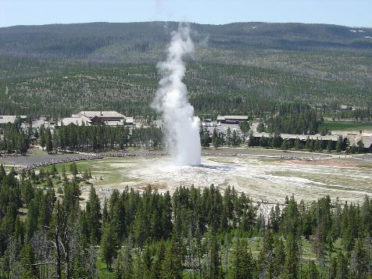
Yellowstone National Park:
Scavenger Hunt
Old Faithful Geyser

Slide 2
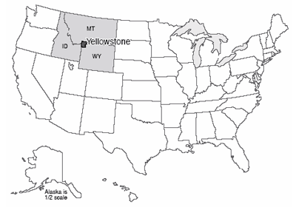
Where is Yellowstone?

Slide 3
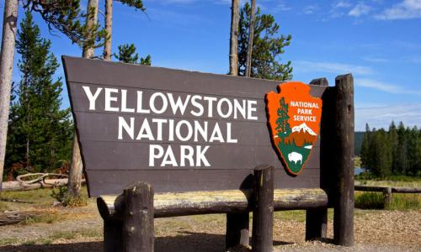
Yellowstone is in…
Idaho
Montana
Wyoming

Slide 4
Scavenger Hunt:
To complete your scavenger hunt worksheet, please go to this website – http://nps.gov/features/yell/interactivemap/

