Slide 1
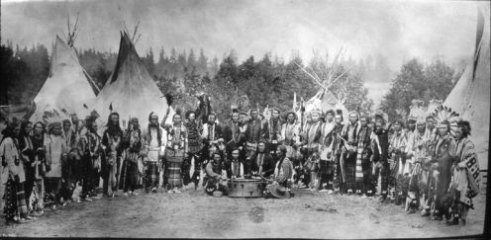
Native Americans of the West!
By: Danielle Mazzola

Slide 2
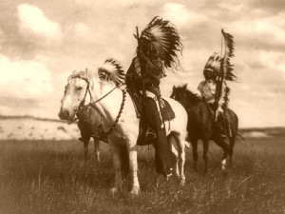
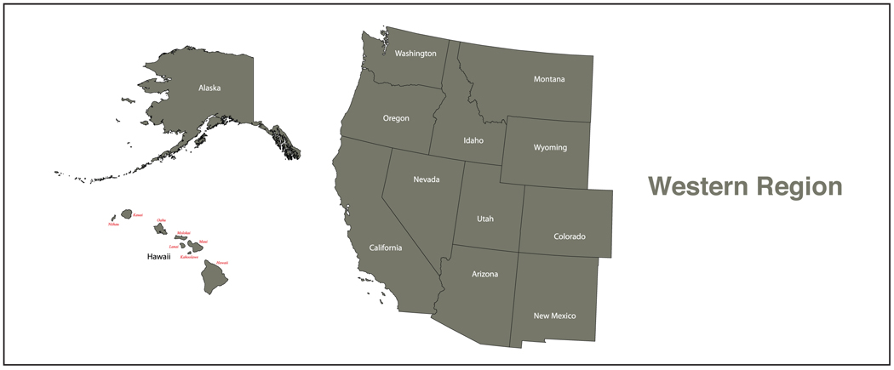
Directions
Click on the picture on each slide to learn about the five Native American tribes of the West and answer the questions on your worksheet. You will hand in your completed worksheet to the teacher at the end.
If you finish early, there are some enrichment activities at the end for you to explore!
GOOD LUCK!

Slide 3
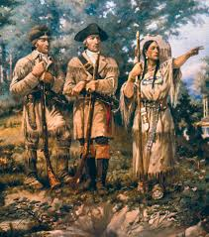
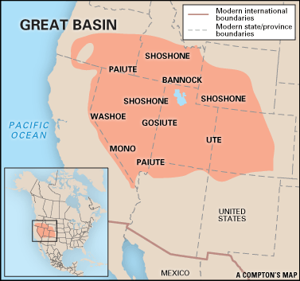
The Shoshone
Where was the Shoshone tribe located?
Who led Lewis and Clark through the West?
How many different groups of the Shoshone were there?
When was the Sun Dance held?

Slide 4
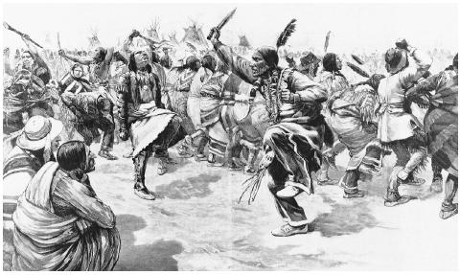
The Paiute
What was the name of the region where the Paiute
tribe was located?
The Paiute strongly believed in “Puha”, which means
.
What was one of their most celebrated
traditions?

Slide 5
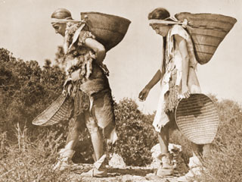
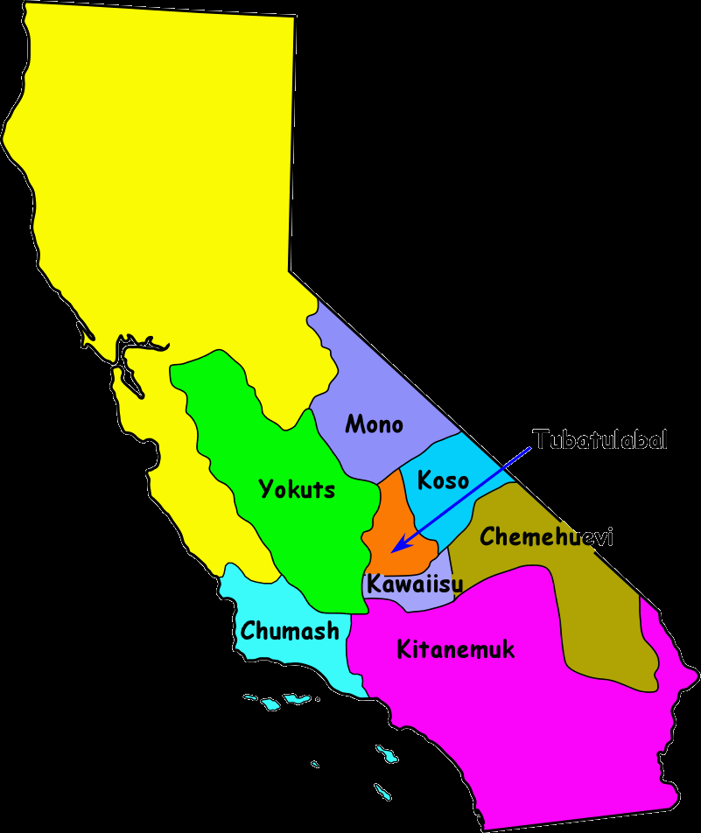
The Yokuts
What part of California did the Yokuts live?
How many people were in each tribe?
What did the Yokuts depend on the land for?
What happened when the settlers moved to the area?

Slide 6
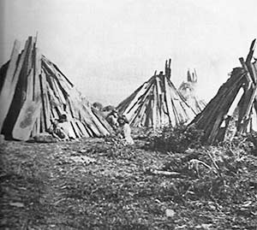
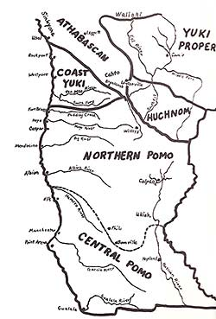
The Pomo
Where were the Pomo Native Americans located?
What did they make for shelter?

Slide 7
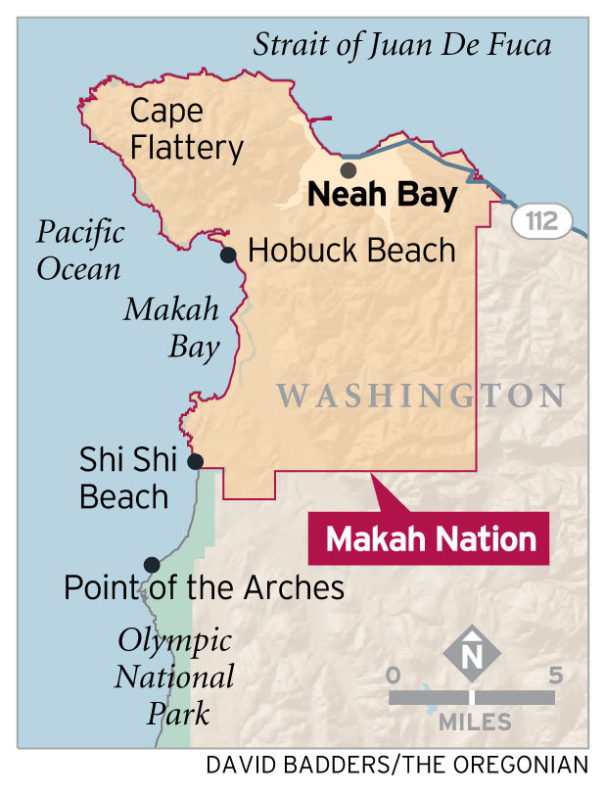
The Makah
What does the name “Makah” mean?
Where did the Makah tribe reside?
What happened to the Makah tribe when the Europeans arrived?

Slide 8
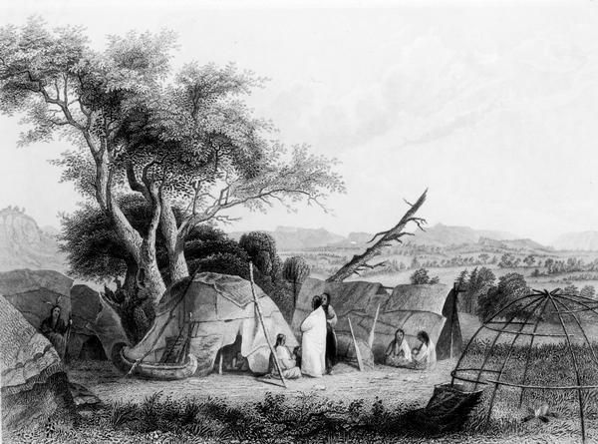
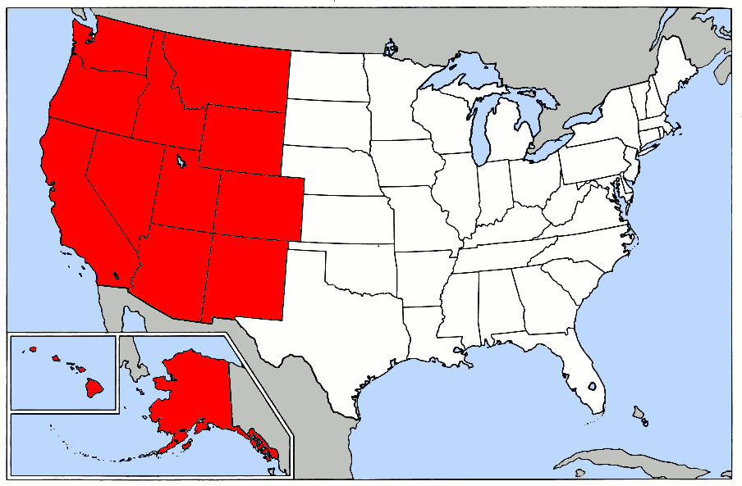
Enrichment Activities
If you have extra time left, click the pictures below to learn even more about the Native American tribes of the West!
Click here to learn more Native American facts! →
Click here to review the Western Region we’ve been
learning about! →

Slide 9
GREAT WORK!!!
You have now completed the web scavenger hunt on the Native Americans of the West! I hope you enjoyed this activity!
Make sure to hand in your worksheet once we have our group discussion!

