Slide 1
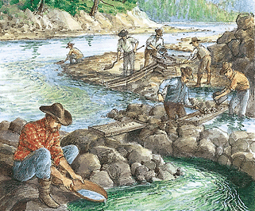
California Gold Rush

Slide 2
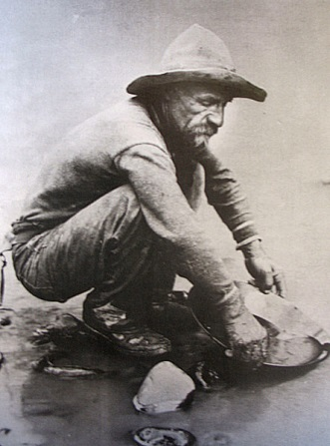
January 24, 1848
On this day, James W. Marshall was constructing a sawmill for a man named John Sutter when he found a gold nugget in the American River.
They tried to keep this news from spreading, but soon it had spread all around the world through sources like newspapers and letters.
After news spread, people from San Francisco were the first to head to where the gold was.

Slide 3
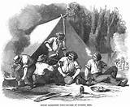
The Journey
By the next year, people from around the world were traveling to California by boats and wagons.
These hopeful miners traveled my three main routes: The Oregon-California Trail, The Panama Shortcut, and Around the Cape Horn.
On their journeys, they had to camp outside, hunt for food, and build fires to survive.
They had to endure all kinds of weather like thunderstorms and sweltering temperatures.

Slide 4
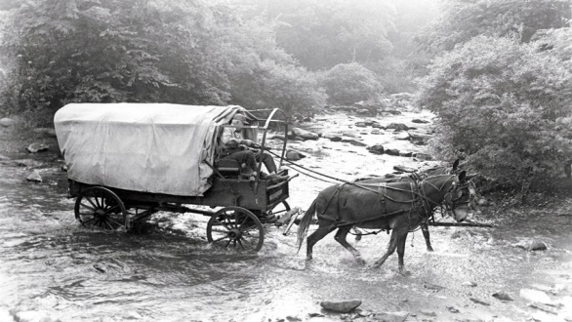
The Journey Continued
Many hopeful miners lost their belongings as they made their way to California and some didn’t even make it there.
Many of them got sick on their journey with illnesses like mountain fever and pneumonia.
Some even took boats to get to California. Like the wagons, it took a very long time to get there and the conditions on the boat were not good.
The ones who made it started arriving in 1849, which is why they were called the forty-niner’s.

Slide 5
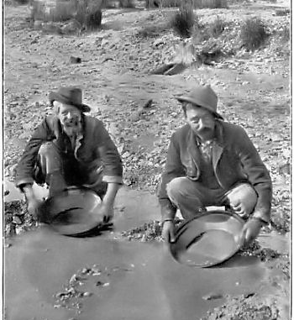
Gold!
The miners who got to California first claimed the best mining sites and quickly collected all of the surface gold that was easier to get to.
The simplest way to find gold was to use a gold pan and pan for dirt, but this method took a long time and was very exhausting.
Another method they used once panning became too difficult was using rockers
As they continued to mine, they had to be more creative with their methods as gold became harder to find and finding it was extremely strenuous.
Many miners went home with nothing, especially when heavy machines were needed to get the rest of the gold out.

Slide 6
Boomtowns
Because thousands of people from around the world came to California at the same time, the population drastically increased.
About 80,000 people arrived and because of this, the small towns got larger and new towns were made to make room for the new people and their needs.
These towns were called boomtowns because they grew so fast.
The largest boomtowns were San Francisco, Sacramento, and Stockton.

