Slide 1
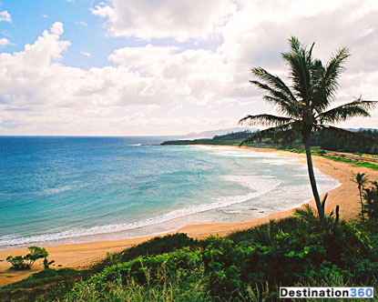
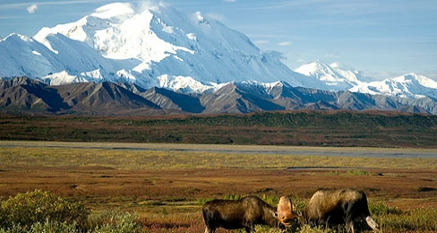
HAWAII AND ALASKA

Slide 2
The West
11 States
Talk about Hawaii and Alaska separately because they are so different

Slide 3
Special States
When places are separated by bodies of water or other places
Non-
Contiguous

Slide 4
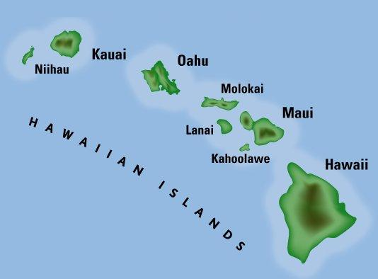
Fast Facts- Hawaii
“The Aloha State”
Chain of 8 islands
Created by volcanoes
Capital: Honolulu
Population: Over 1 million
Approximately 6500 square feet

Slide 5
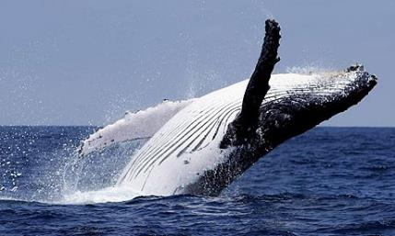
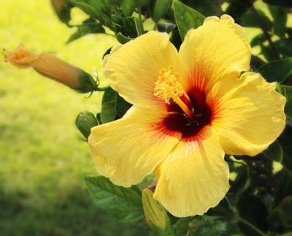
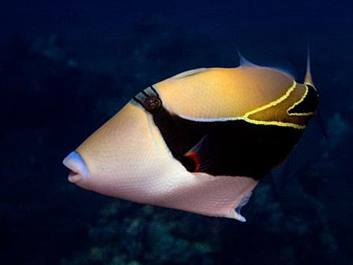
State Symbols: Hawaii
State Mammal: Humpback Whale
State Flower: Yellow Hibiscus
State Fish: Humuhumunukunukuapua`a
“aka” Rectangular Triggerfish

Slide 6
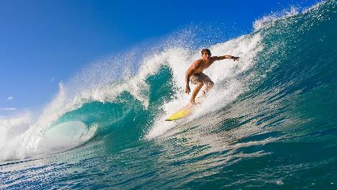
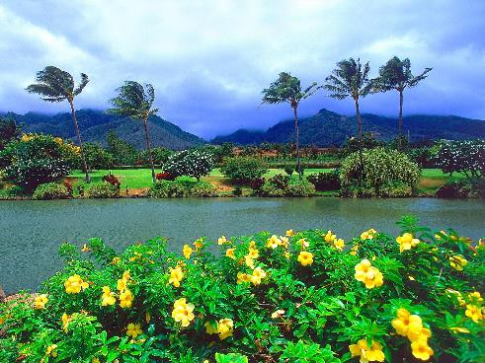
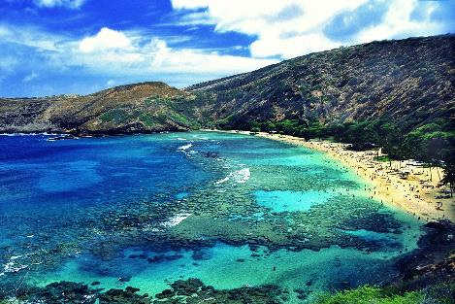
Climate - Hawaii
Subtropical- very wet
Coasts warmer than inland
Sunny and Warm
Closer to the equator

Slide 7
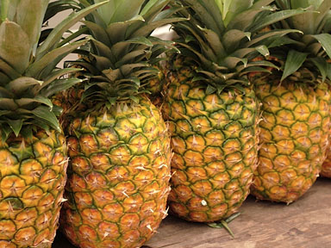
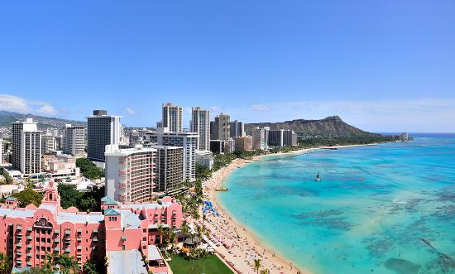
Economics- Hawaii
Products
Tourism
Sugarcane, fruits, veggies, pineapple, coffee
Millions of people travel to the beautiful Hawaiian Islands every year

Slide 8
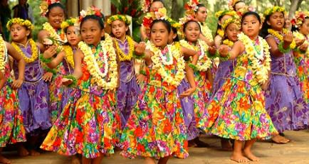
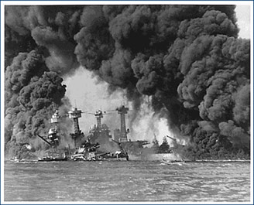
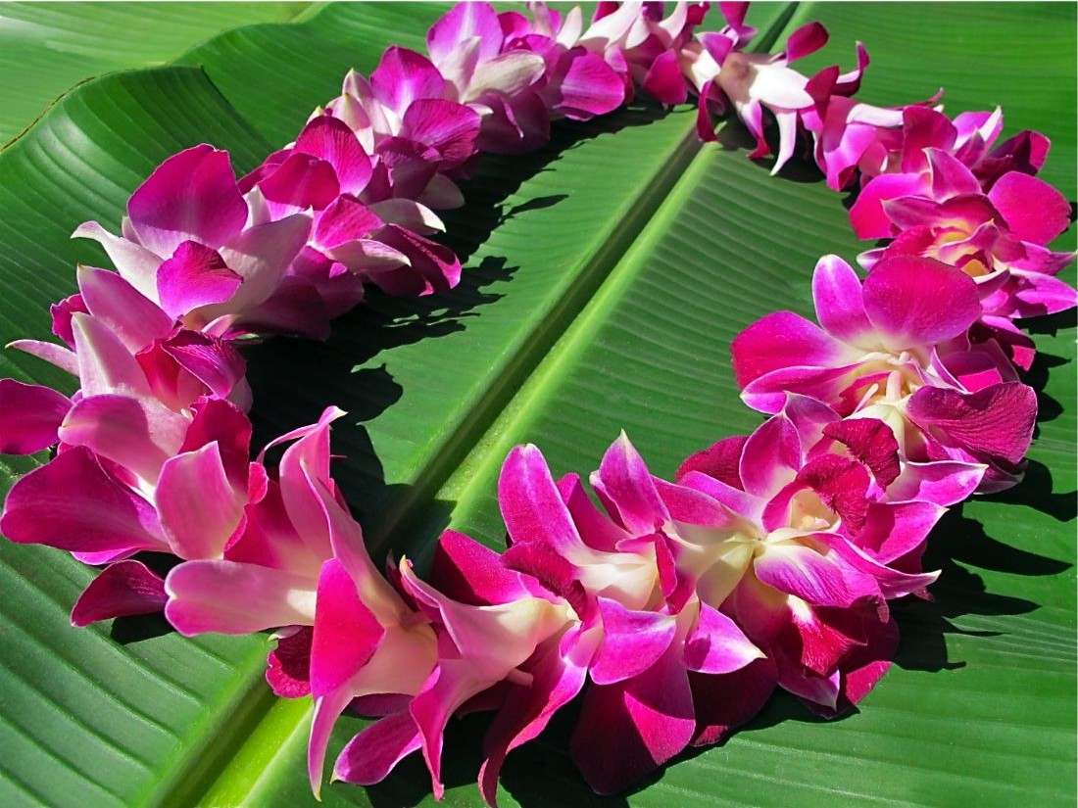
History and Culture: Hawaii
50th state
Pearl Harbor
Hawaiian kings
Traditions
Hula dance
Leis: flower wreath

Slide 9
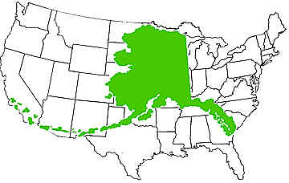
Fast Facts- Alaska
“The Last Frontier”
Capital: Juneau
Population: 700,000
Approximately 570,000 square feet
Over twice the size of Texas

Slide 10
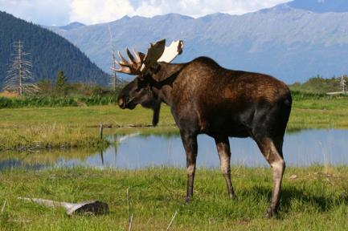
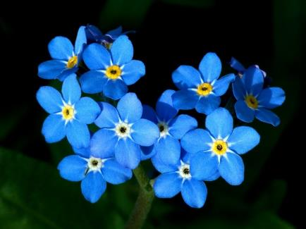
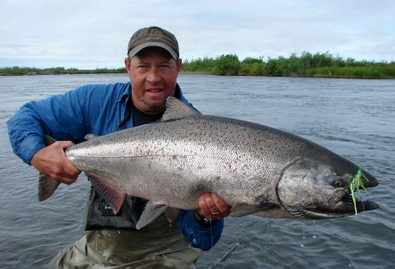
State Symbols: Alaska
State Mammal: Moose
State Flower: The Forget-me-not
State Fish: King Salmon

Slide 11
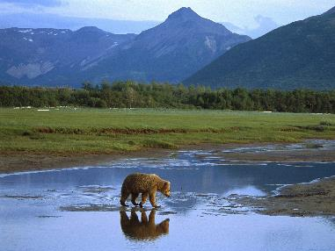
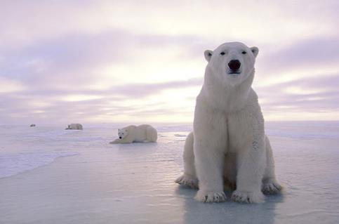
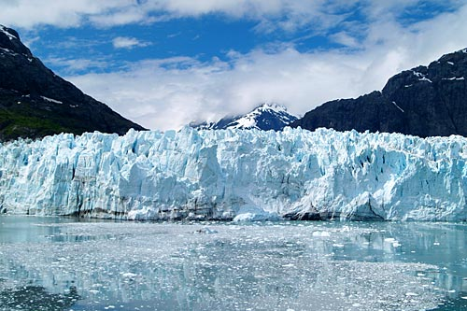
Climate- Alaska
Cold winters and mild summers
Frozen tundra
Wilderness
Glaciers

Slide 12
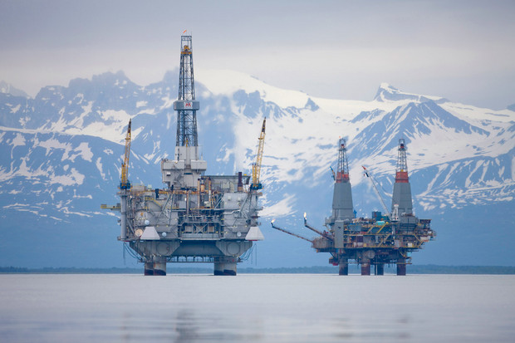
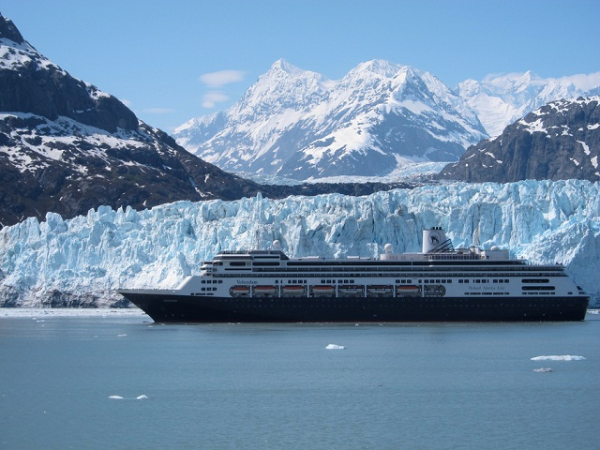
Economics- Alaska
Products
Tourism
Seafood, oil, timber, furs, fertilizer, zinc, coal, ore
People come to see over 100,000 glaciers

Slide 13
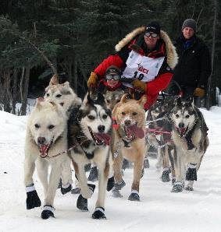
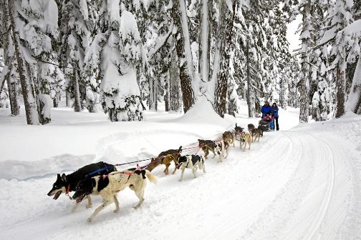
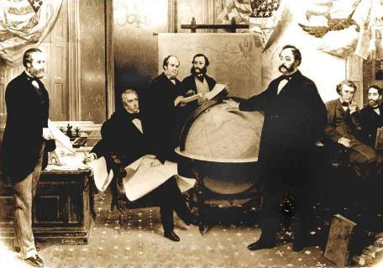
History and Culture: Alaska
History: 49th state
purchased from Russia
Dogsledding Races
Iditarod- 9 day race, 1850 kilometers

Slide 14
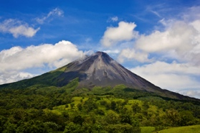
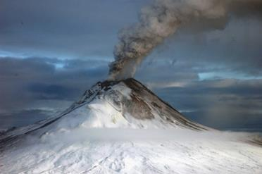
Similarities
Non-contiguous
Beautiful natural resources and places
Get money from visitors and exports
Both have their own time zone!
Volcanoes!!

